Slide 1
KeyStroke Dynamics for User Authentication
Presented By:
Rakshith Churchagundi Amarnath - A20424771
Aditya Prakash Yaji - A20426486
Urvi Chandreshkumar Sheth - A20430232

Slide 2
What is KeyStroke Dynamics?
Keystroke dynamics are a powerful behavioral biometric measurement capable of determining user identity and for continuous authentication.
It utilizes the manner and rhythm in which each individual types.
It is an unobtrusive method that can complement an existing security system such as password scheme.

Slide 3
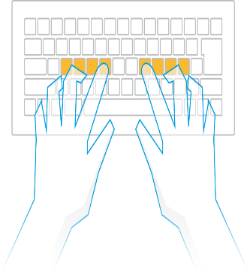
Why KeyStroke Dynamics?
One-time authentication like passwords can be breached or hacked.
An extra layer of security for the user to confirm that the user is an authorized user, on an ongoing basis like Keystroke dynamics.
Its unobtrusive.
There is no requirement for additional hardware, which makes it economical.

Slide 4
Proposal
In the project, we will verify the identity of users on the basis of the keystroke information.
A model will be first trained by providing it with the typing patterns of the users to be enrolled, multiple patterns per user.
The model is then provided with test patterns from the user as well as others posing as that user. The model should be able to reject the imposters while accept the genuine user based on the test pattern similarity to the trained model for the user.
We will test various detectors which provide different ways of measuring this similarity.
Manhattan Distance
Euclidean Distance
K-Nearest Neighbours

Slide 5
Datasets
Dataset-1:
We are collecting user keystroke information w.r.t the name of the user.
We have developed a python code to collect the data using pyHook library.
Steps to collect data:
The python code first ask for the name of the user and then will ask to enter the data. It takes input from A-Z a-z 0-9 and some special char (Ascii values from 33 to 122).
After data collection, it is stored for calculating H, DD and UD values for each user input and using that for the anomaly detection.
Example:
user | key | keyEvent | Time
rakshith | 13 | Up | 126960187

Slide 6
Datasets (contd.)
Dataset-2:
The dataset-2 for this project is the CMU Keystroke Dynamics Benchmark Data-set.
It contains the keystroke information for 51 users, each user typing the password “.tie5Roanl” 400 times.
The data has been collected over several variations between the user’s typing can be captured.
Example:
subject | sessionIndex | rep | H.period | DD.period.t | DD.period.t
s002 | 1 | 1 | 0.1491 | 0.3979 | 0.2488

Slide 7
Survey of Relevant Work
The dataset which is gathered by CMU Keystroke Dynamics Benchmark Data[1] set labeled as dataset 2 is used for the reference as explained above.
As the dataset was controlled for the factores like the pattern and the length of the data the model was not highly accurate when it comes to real time gibberish data
So we tried to identify how the data was collected and successfully implemented the gibberish data collector which is explained above as dataset 1.
After collecting our own dataset we applied 3 anomaly detection methods to compare the results.
[1] http://www.cs.cmu.edu/~keystroke/KillourhyMaxion09.pdf

Slide 8
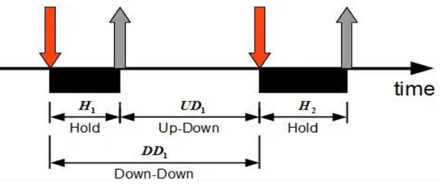
Experimental Design
Keystroke data is collection of timing data for the typing events.
Data Acquisition:
For both the datasets, the users were supposed to type some alphanumeric string for which keyUp and KeyDown event with time stamps are acquired
Feature Extraction
As shown in figure, using keyup and keydown timing for a single key, Hold(H), Up-Down(UD) and Down-Down(DD) timings are extracted
Feature Engineering
After the features has been extracted, different algorithmic model has been trained on the data acquainted

Slide 9
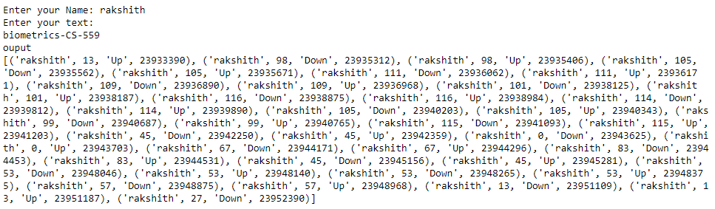
Method and Implementation
In Collecting keystroke file, we wrote a program in python to get user name and user input data in alphanumeric format. We used a python library named pyHook which allowed us to record keystroke events and their timestamps. We stored the basic keystroke information in Collecting_keyStroke.csv

Slide 10
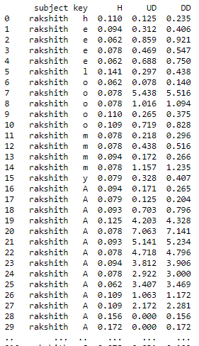
Method and Implementation (Contd.)
After that, the feature extraction is done from the keystroke data to calculate values like H, DD and UD.
We are taking each user information and finding difference between keyUp - keyDown timestamps grouped by each keystroke and each type of user
As shown in screenshot for user “rakshith” different instances of different alphabets is shown
Stored in keystrokedistance.csv

Slide 11
Method and Implementation (Contd.)
After the feature extraction, we are training 3 algorithms to the both datasets which can be used for prediction/authentication
The Algorithms
Manhattan - The distance between 2 points measured along axes at right angles
Euclidean - The straight line distance between 2 points
K-means - Distance Functions

Slide 12
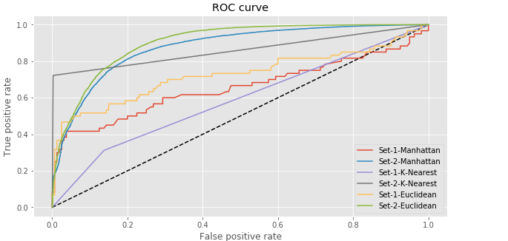
Testing Results

Slide 13
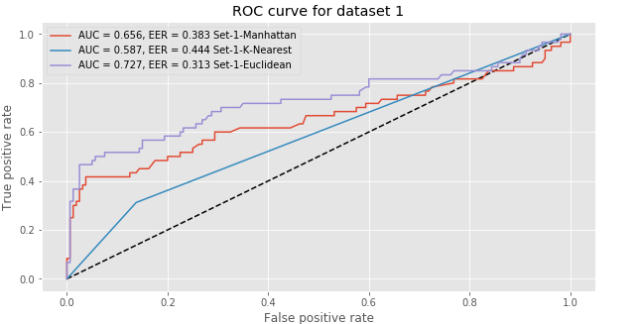
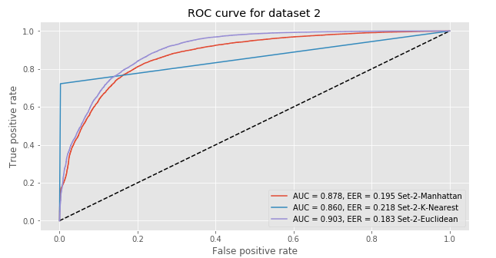
Testing Results

Slide 14
Conclusions
Methods | Error rate from different dataset
 | Dataset 1 | Dataset 2
Manhattan | 0.383 | 0.195
Euclidean | 0.444 | 0.218
K-Means | 0.306 | 0.155

